Slide 1

Demo
Gastrointestinal Endoscopy Training System

Slide 2
Project
Unity3D Engine
OpenGL ES 3.0
Shader HardWare Tier 3
Game Scene and Logic
Mimics
STL Model
Mobile App
( Game Handle )

Slide 3
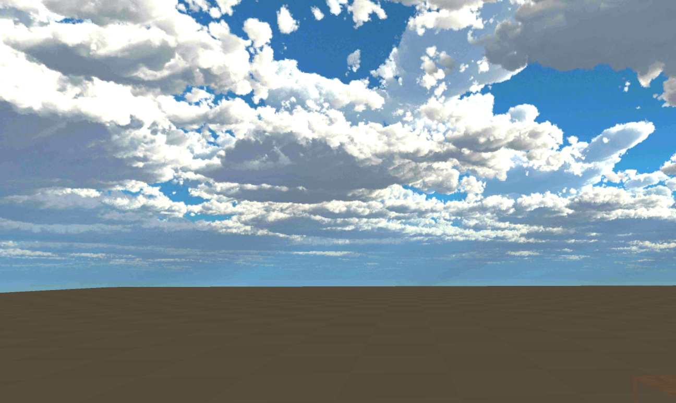
House Model & Sky Box
Add to Camera (could change the sky box when changing the camera)
Add to Scene
Find Assets in the online Asset store

Slide 4
Double JoyStick & Camera
Left JoyStick
Control go forward, go back, go left, go right
Move around in the house
Move around in the gastric model
Right JoyStick
Control the view to rotate

Slide 5
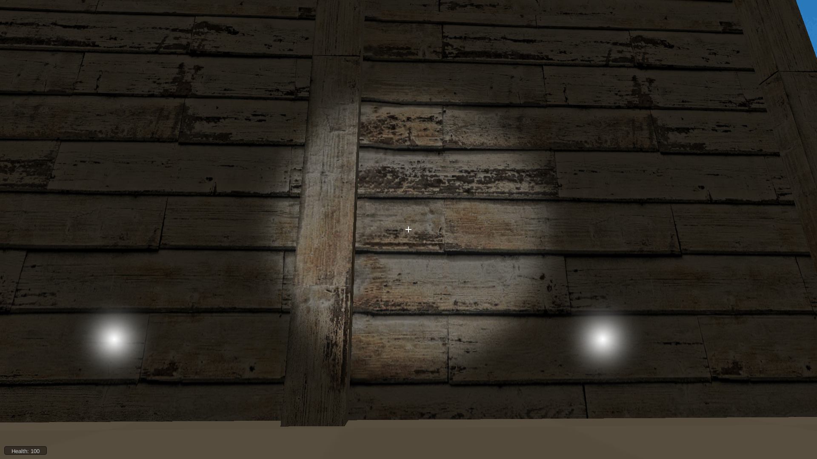
Light
Environment Light in the house
Only spotlight in the gastric model
Parameters
spot light : Intensity; Spot Angle; Color; Range;
environment light

Slide 6
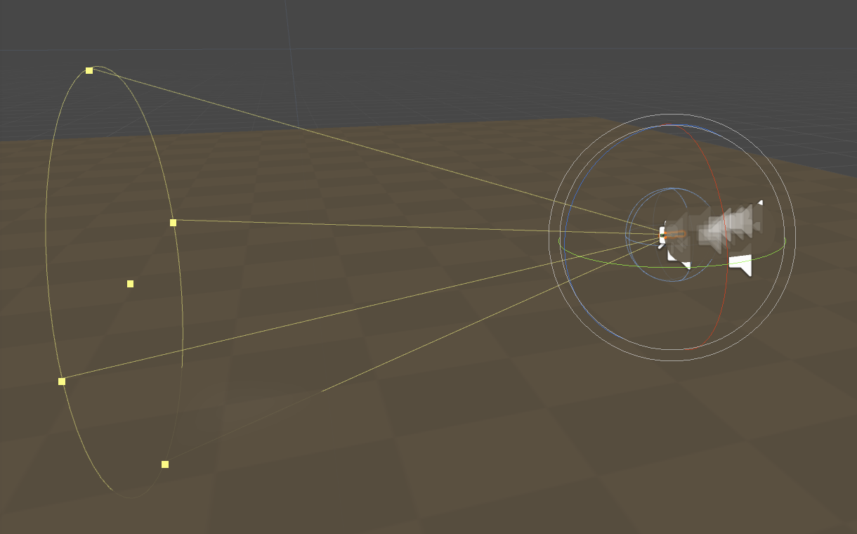
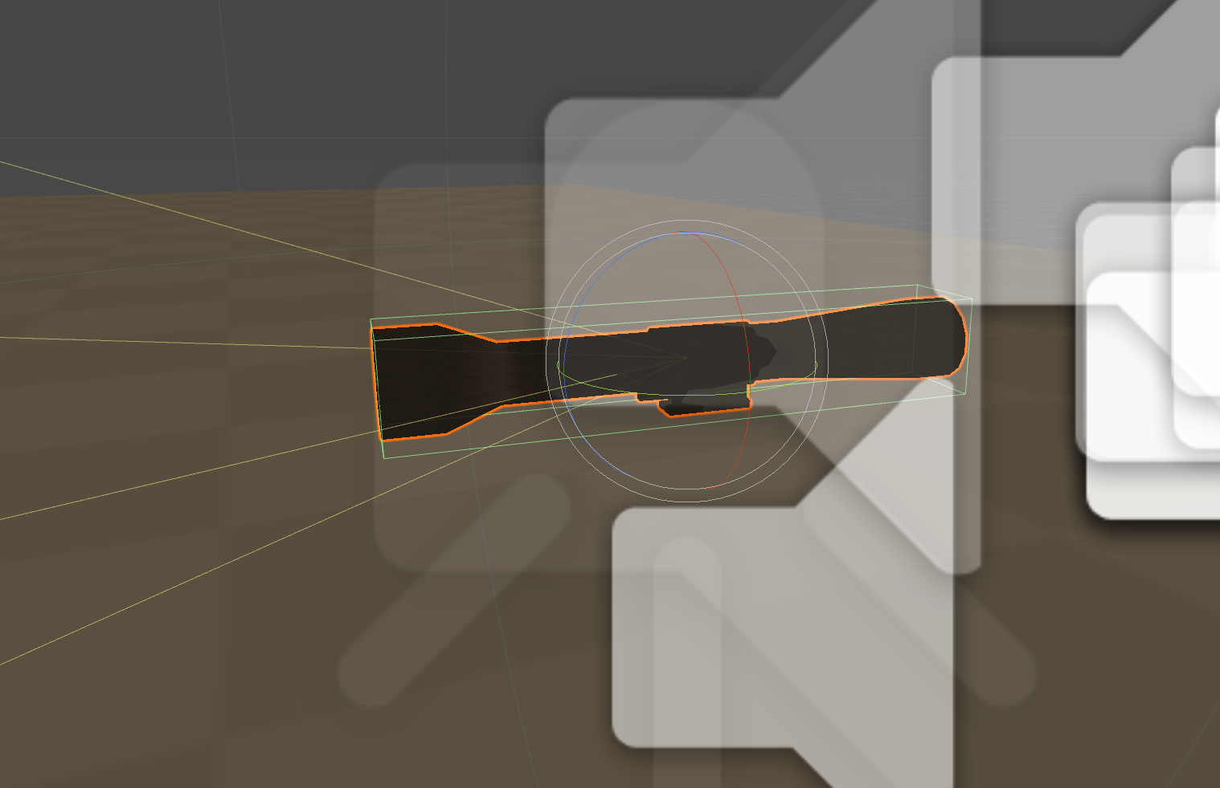
Spot Light Model
Simulate the torch
Move with the spot light

Slide 7

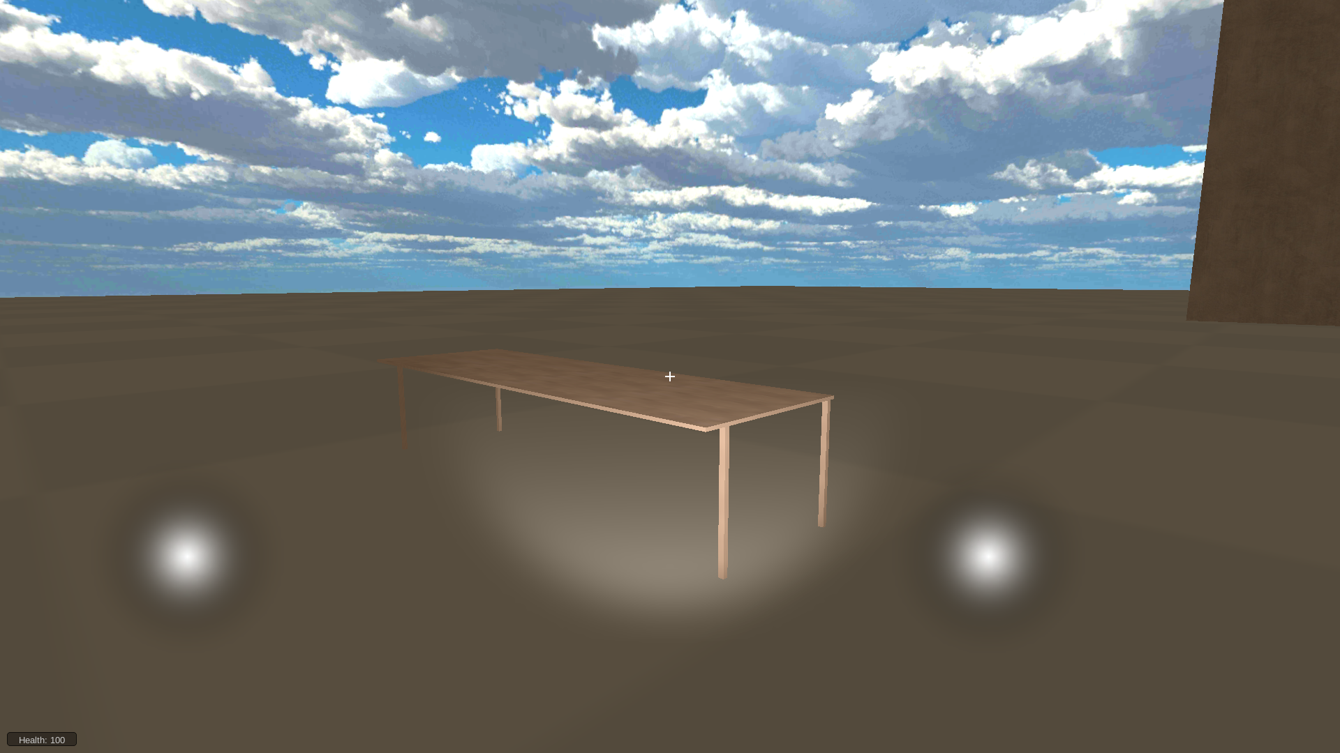
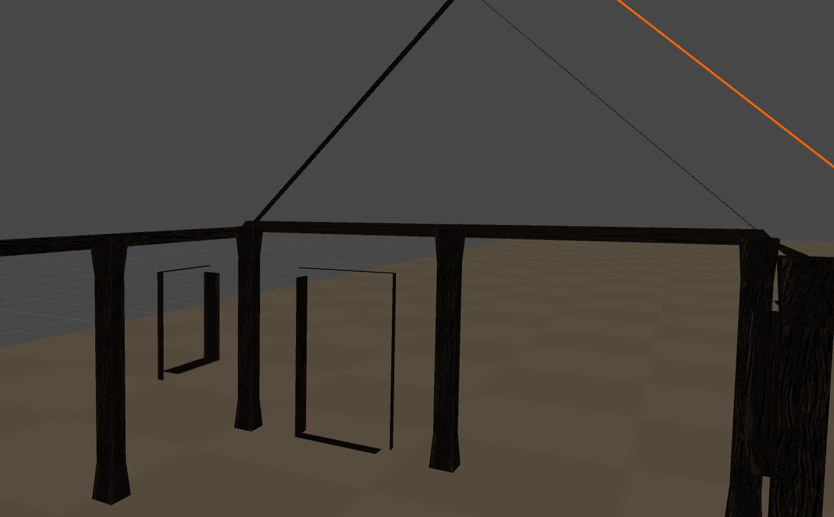
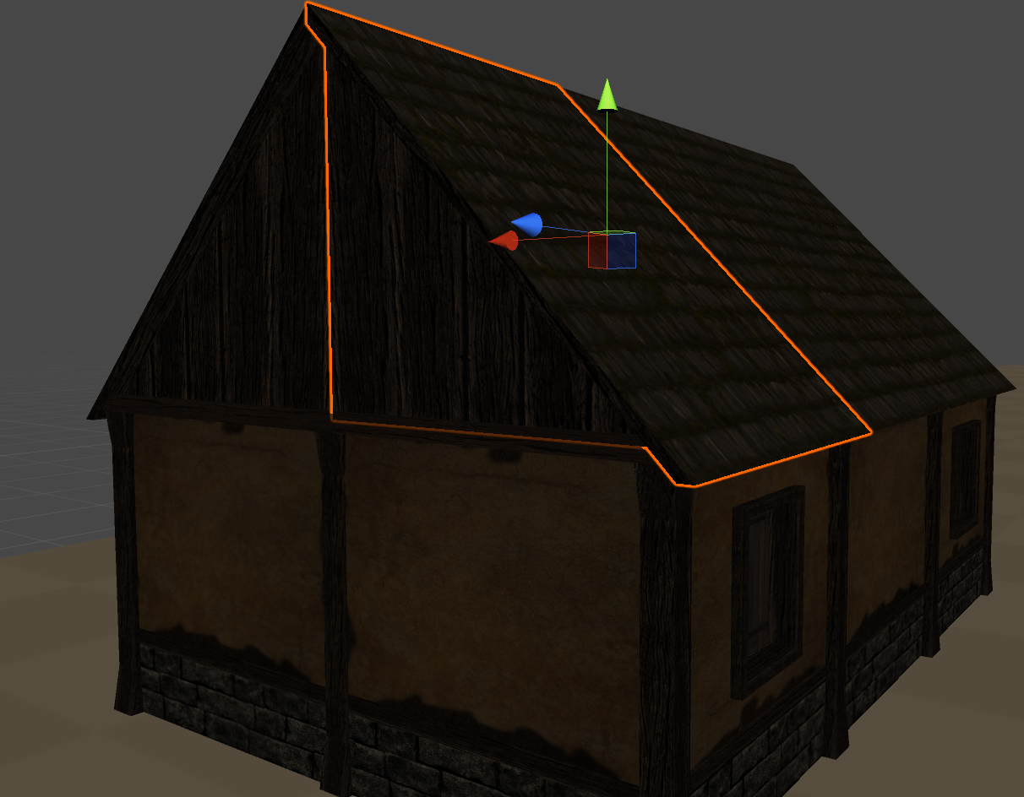
Objects & House Model
Can’t use normal 3D Model
Occlusion clip
Inner House

Slide 8
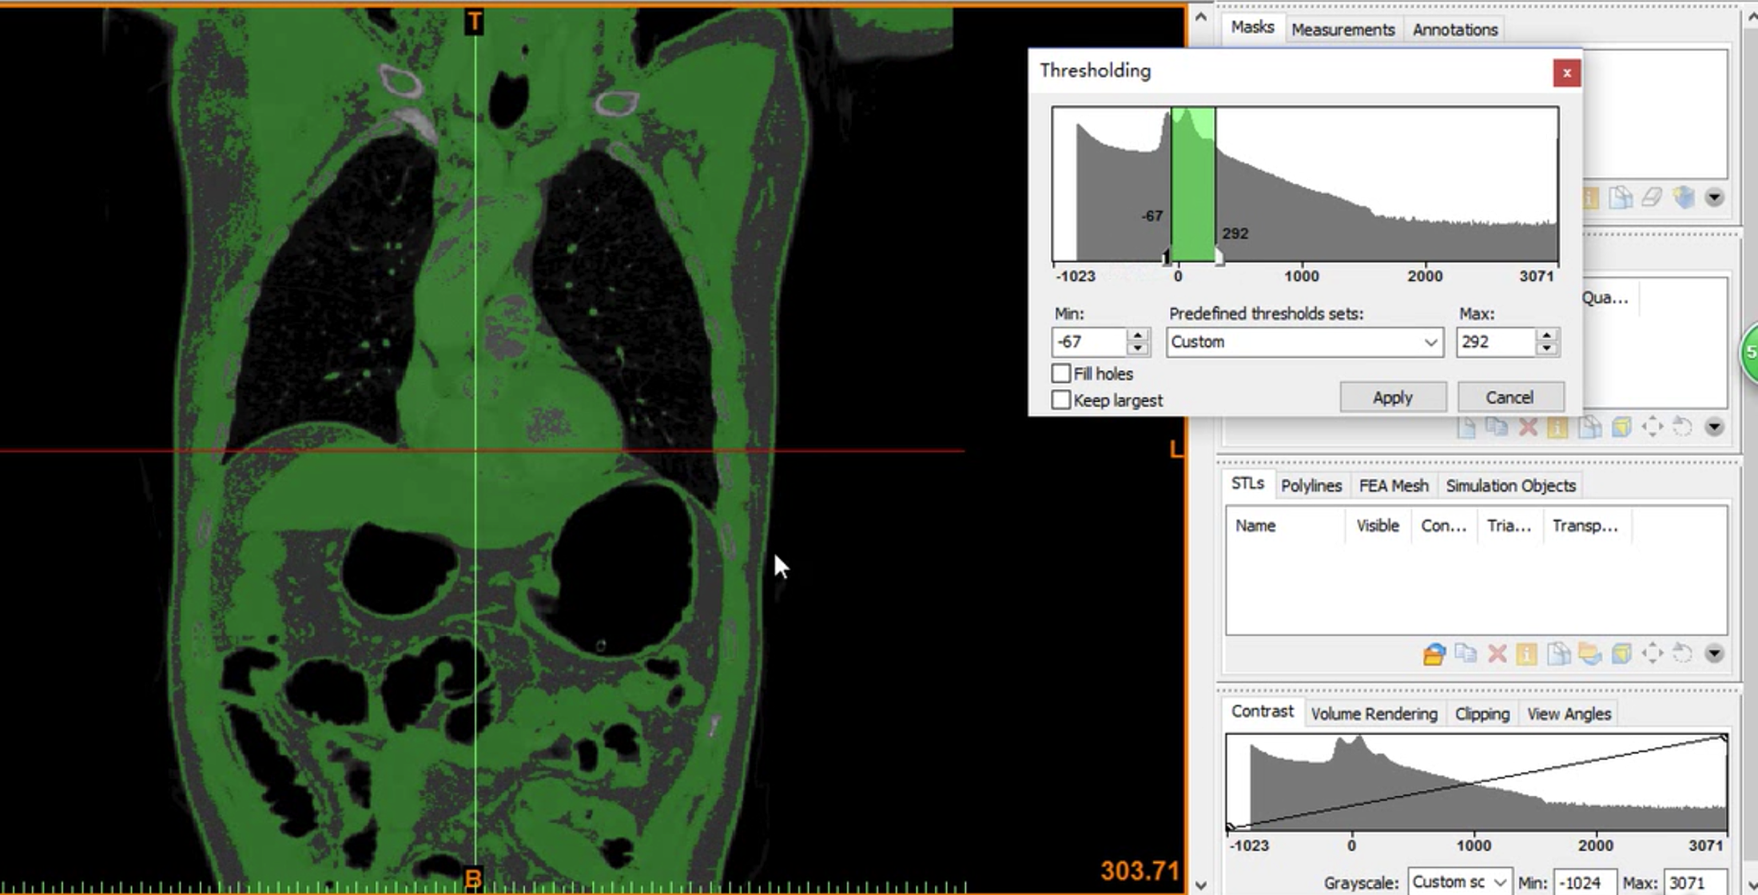
Mimics & CT & Gastric Model

Slide 9
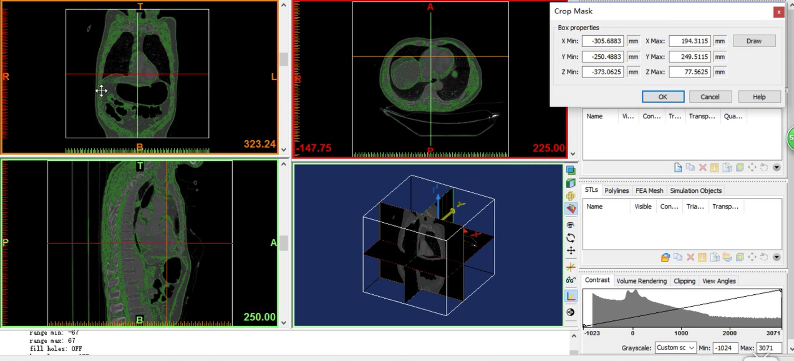
Mimics & CT & Gastric Model

Slide 10
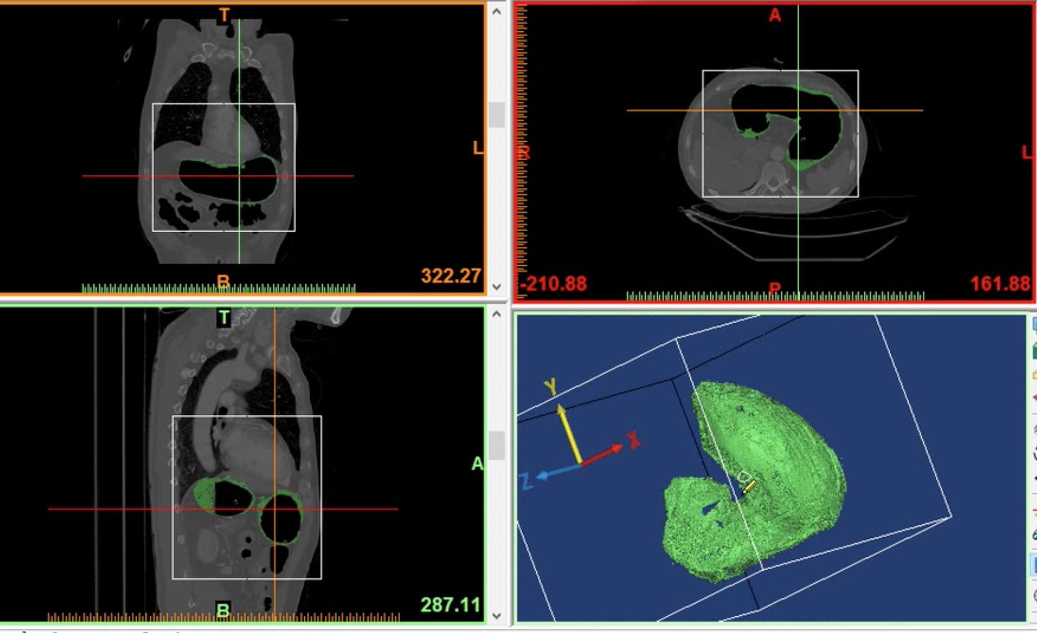
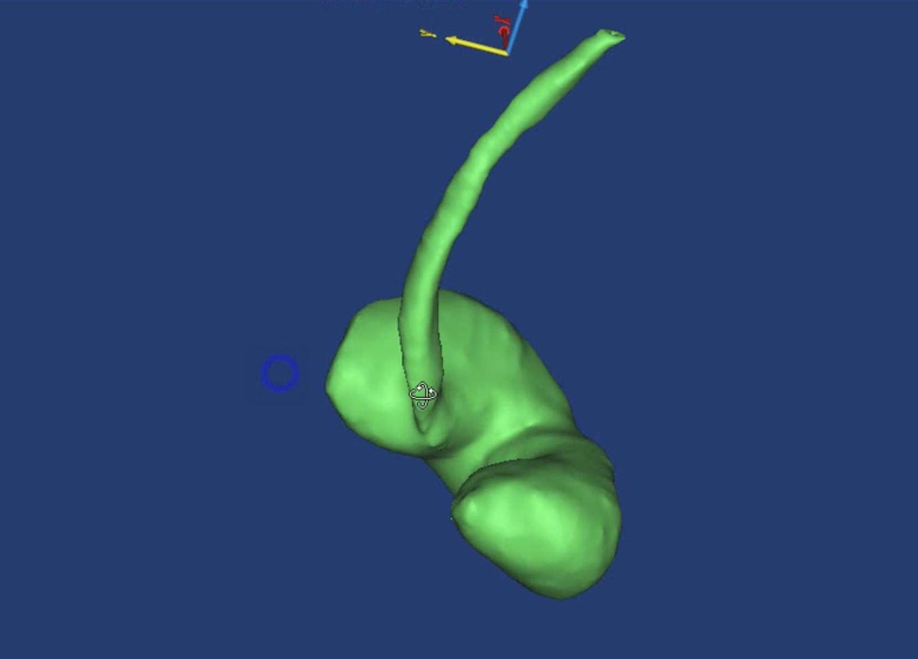
Mimics & CT & Gastric Model

Slide 11
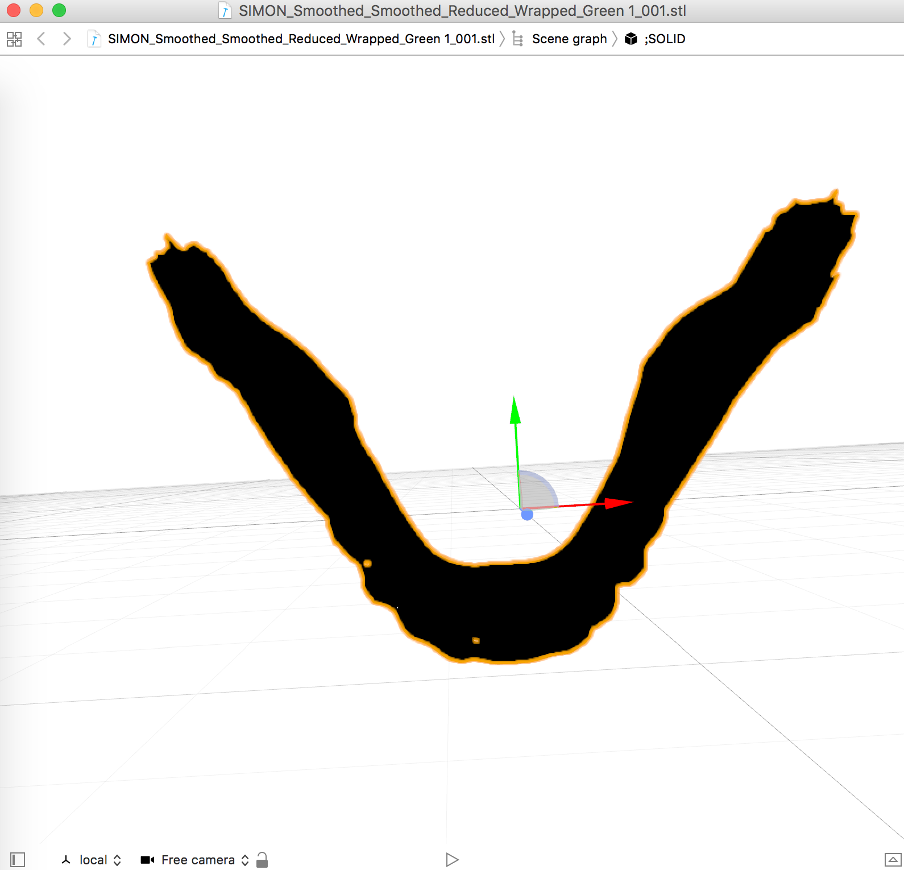
STL & Unity
\

Slide 12
STL & Unity
https://blog.csdn.net/qq992817263/article/details/72738344
Instantiate STL Model in the Scene
Read the information of Vertex
Create the GameObject
Mesh Compression(delete repeated vertex)

Slide 13
For More Information
Gastric Model
More CT to reconstruct the 3D model
Texture
Expand
Interact with the Game Handler
Camera Control
Implement User Interface
Build Inner House

